Slide 1
Formal Verification of Programs Equivalence
João Nini
Advisor: Mário Pereira
December 16, 2025

Slide 2
Motivation
Annoying bugs in games
Errors in food delivery apps
Therac-25 radiation overdoses
AWS and Cloudflare outages
Avoidable!
What is the most reliable way?
Deductive verification
Notes:
Todos nós já passámos por situações em que percebemos um erro nalgum tipo de software, seja um site, aplicação ou jogo.
Alguns destes casos incluem, por exemplo, bugs irritantes num jogo que nos fazem perder uma partida ou problemas em aplicações de entrega de comida ao domicílio que nos fazem ficar sem almoço ou que, pelo menos, este demore mais tempo a chegar.
No entanto, nenhuma destas situações é comparável a casos em que erros de software levam a perda de vidas humanas ou expressivos danos económicos.

Slide 3
Our Vision
Deductive verification’s most common way: just write and validate the proof of the program
Consider a specific case where we have two versions of the same program: one simple but slow (P1) and another complex but efficient (P2)
How to prove correctness of P2?
- Our approach: prove that P1 is correct and then establish that P1 and P2 are equivalent
Why?
- Proving equivalence is often simpler than proving correctness of complex programs

Slide 4
Problem Definition
Can we automatically prove that two different programs are equivalent?
Notes:
Quando falamos em prova automática de equivalência, queremos dizer sem interação do utilizador depois da escrita da especificação.

Slide 5
Presentation Structure
WhyRel
bip2ml
Case Studies
Conclusions

Slide 6
WhyRel

Slide 7
What is WhyRel?
A tool that aims to verify relational properties of pointer programs based on relational region logic
These auto-active tools enable the verification of a larger set of programs but require more user input
WhyRel works as a translator for the why3 platform to perform formal verification
WhyRel is the most important practical work for this thesis

Slide 8
From bip2ml 2 WhyRel
Why bip2ml?
To allow programmers to verify relational properties about their OCaml projects without needing to:
- Completely rewrite the code
- Learn a different programming language

Slide 9
bip2ml

Slide 10
What is bip2ml?
Our main contribution
A transpiler that eases verification of relational properties about OCaml programs
Transpiles biprograms using the translation rules defined by WhyRel’s authors
Input: Gospel-annotated BipLang code
Output: Gospel-annotated OCaml code

Slide 11
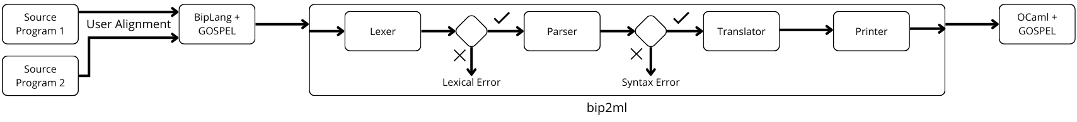
bip2ml + Cameleer Architecture

Slide 12
BipLang
Simplifies writing biprograms and is based on the biprograms language used in WhyRel’s work
Designed to be as similar as possible to OCaml in terms of syntax and semantics
Some OCaml features are missing, but we add 3:
- Pipe: <|>
- Floors: |_ and _|
- Conditionally aligned loops

Slide 13
Motivating Example (1/2)
let example (|_ x : int _|) : |_ int _| = begin
let y = x + 2 <|> x * 2 in
|_ y _|
end
(*@ requires x_l = 2 && x_l = x_r
ensures match result with (l_res, r_res) -> l_res = r_res *)
BipLang
Notes:
A nocao de equivalência baseia se na ideia de que existem um programa esquerdo e um direito. Existem dois mundos que não se tocam para simularmos dois programas a executar ao mesmo tempo.
Floor divide-se em representações para o lado esquerdo e direito.
Pipe: à esquerda raciocinamos sobre programa esquerdo e à direita sobre programa direito.
Parametros, tipo de retorno, let e return.

Slide 14
Motivating Example (2/2)
let example (x_l : int) (x_r : int) : int * int =
let y_l = (x_l + 2) in
let y_r = (x_r * 2) in
(y_l, y_r)
(*@ requires x_l = 2 && x_l = x_r
ensures match result with (l_res, r_res) -> l_res = r_res *)
OCaml
Input: let y = x + 2 <|> x * 2 in
Result: let y_l = x_l + 2 in let y_r = x_r * 2 in
Input: |_ y _|
Result: (y_l, y_r)

Slide 15
bip2ml Visualizer
Allows using bip2ml in a website through a client-server dynamic (local only for now)
Enables visualization of BipLang and OCaml ASTs, as well as simplifying their comparison

Slide 16
bip2ml Visualizer Demo

Slide 17
Case Studies

Slide 18
Induction Variable Strength Reduction -
Source Program
let induc_var_strength_red_source (b : int, c : int, n : int) : int = begin
let i = ref 0 in
let j = ref 0 in
let x = ref 0 in
while !i < n do
j := !i * b + c;
x := !x + !j;
i := !i + 1
done;
!x
end
BipLang

Slide 19
Induction Variable Strength Reduction -
Optimized Program
let induc_var_strength_red_optimized (b : int, c : int, n : int) : int = begin
let i = ref 0 in
let j = ref c in
let x = ref 0 in
while !i < n do
x := !x + !j;
j := !j + b;
i := !i + 1
done;
!x
end
BipLang

Slide 20
Induction Variable Strength Reduction - Biprogram
let induc_var_strength_red_biprogram (|_b : int_|, |_c : int_|, |_n : int_|) : |_int_| = begin
let i = |_ ref 0 _| in
let j = ref 0 <|> ref c in
let x = |_ ref 0 _| in
while |_ !i < n _| do
(*@ variant n_l - !i_l
invariant !i_l = !i_r
invariant !x_l = !x_r
invariant !j_r = !i_r * b_r + c_r *)
j := !i * b + c <|> x := !x + !j;
x := !x + !j <|> j := !j + b;
i := |_ !i + 1 _|
done;
|_ !x _|
end
(*@ requires b_l = b_r && c_l = c_r && n_l = n_r
ensures match result with (l_res, r_res) → l_res = r_res *)
BipLang

Slide 21
Induction Variable Strength Reduction -
Product Program (1/2)
let induc_var_strength_red_ocaml (b_l : int) (b_r : int) (c_l : int) (c_r : int) (n_l : int) (n_r : int) :
int * int =
let i_l = ref (0) in
let i_r = ref (0) in
let j_l = ref (0) in
let j_r = ref (c_r) in
let x_l = ref (0) in
let x_r = ref (0) in
while (!i_l < n_l) do
(*@ invariant ((!i_l < n_l)) ↔ ((!i_r < n_r))
variant n_l - !i_l
invariant !i_l = !i_r
invariant !x_l = !x_r
invariant !j_r = !i_r * b_r + c_r *)
OCaml

Slide 22
Induction Variable Strength Reduction -
Product Program (2/2)
j_l := ((!i_l * b_l) + c_l);
x_r := (!x_r + !j_r);
x_l := (!x_l + !j_l);
j_r := (!j_r + b_r);
i_l := (!i_l + 1);
i_r := (!i_r + 1)
done;
(!x_l, !x_r)
(*@ requires b_l = b_r && c_l = c_r && n_l = n_r
ensures match result with (l_res, r_res) → l_res = r_res *)
OCaml

Slide 23
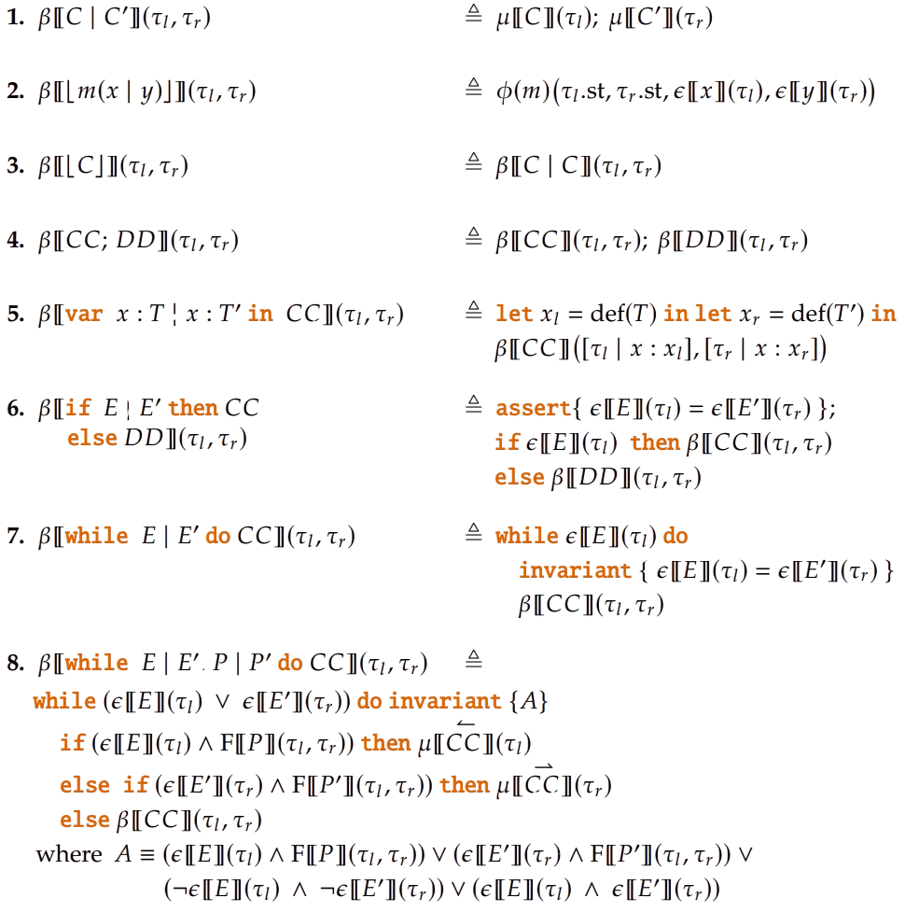
Translation Rules

Slide 24
Conclusions

Slide 25
Contributions
Verify program equivalence and other relational properties
Bring the translation rules of WhyRel into the world of OCaml
bip2ml – OCaml relational verification tool
BipLang – adaptation of OCaml

Slide 26
Limitations
BipLang does not contain all OCaml features
Automatic verification depends on the interpretation of “automatic”

Slide 27
Future Work
Higher-order constructs (iter, fold…)
Pointer based programs
Dynamic programming
Program evolution

Slide 28
Formal Verification of Programs Equivalence
Thank you!
João Nini
Advisor: Mário Pereira
December 16, 2025

